Slide 1
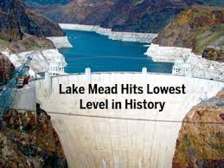
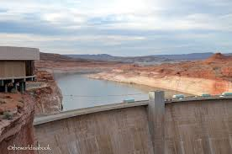

COLORADO RIVER BASIN
UPDATE AND STATUS
Presented to
Arizona Water Banking Authority
June 22, 2016
Lake Powell

Slide 2
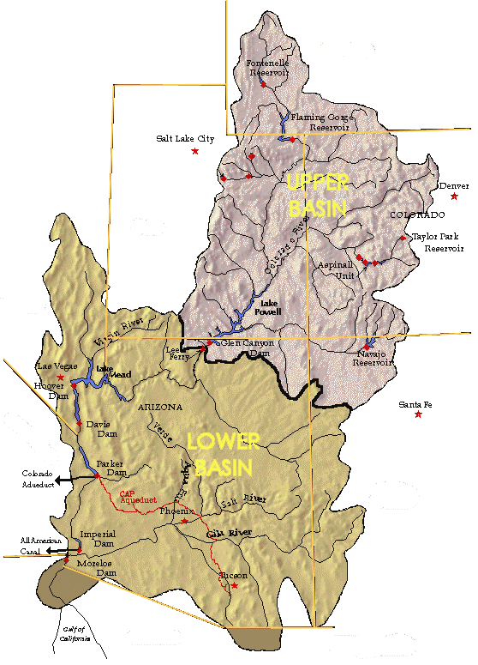

COLORADO RIVER SYSTEM
RESERVOIR STATUS
73%
WYOMING
Fontenelle
91%
TOTAL SYSTEM CONTENTS – 51% or 30.66 MAF
Flaming Gorge
June 2016
Updated June 14, 2016
UTAH
Lake Powell
COLORADO
3,651 ft, 2016 Equalization Level
50% 12.12 MAF
69%
Blue Mesa
3,603.87 ft
NEVADA
89%
Lake Mead
Morrow Point
36% 9.50 MAF
91%
1,073.18 ft
ARIZONA
Navajo
1,075 ft, First Tier Shortage
NEW MEXICO
CALIFORNIA
Data Source: US Bureau of Reclamation
Notes:
Total reservoir system contents is 51% or 30.66 MAF.
At the beginning of June, Lake Mead was 36% full (9.5 MAF at elevation 1,073.18 feet). Lake Mead will continue to decline through the end of June before reaching a projected elevation of 1,072.15 feet, the lowest since Lake Mead filled.
Lake Powell is currently 50 % full (12.12 MAF at elevation 3,603.87 feet).

Slide 3
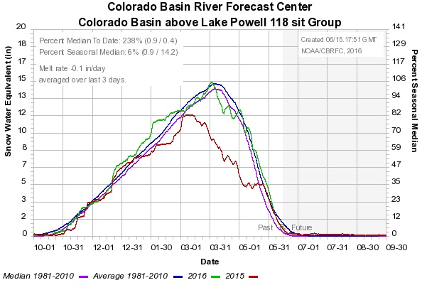
COLORADO RIVER BASIN FORECAST CENTER
CURRENT SNOWPACK
2016 Snowpack Peaked on April 2nd
April and May Had Slightly Above Normal Precipitation and Helped Reduce Early Snowmelt
Warm and Dry February Caused a Decrease in 2016 Snowpack
2016 Snowpack Nearly All Melted Off
Notes:
Slide is explanatory. A somewhat wetter than normal April and early May helped reduce snowmelt and added to the snowpack.

Slide 4
COLORADO RIVER BASIN FORECAST CENTER
INFLOW FORECAST
June 3, 2016
Notes:
Based on the current inflow forecast, the inflows for the April / July time-period into Lake Powell is 6.5 MAF, which is up 0.5 MAF since the May forecast. This is 91% of normal.
Inflows affect the amount of storage in Lake Powell and ultimately what could be released into Lake Mead.

Slide 5
El Nino Forecast
El Nino Is Over with a 75% Chance of La Nina in Fall 2016
Source: National Oceanic and Atmospheric Administration – Climate Prediction Center
Notes:
There was much talk about the very strong El Nino (red bars) and what effect it would have on snowpack and runoff this season. While it started out promising, it has now ended. Current projections show high probability of a La Nina episode (Blue bars) by the fall.

Slide 6
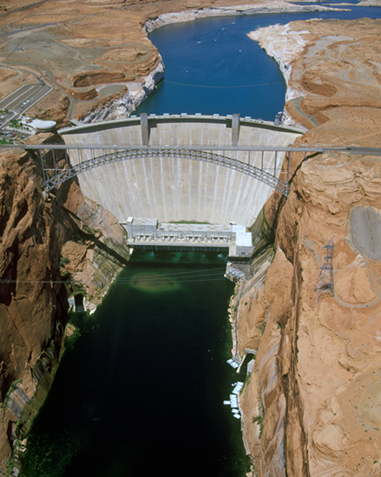
LAKE POWELL RELEASE – “APRIL ADJUSTMENT”
Lake Powell releases are one of the key determinants for projected shortages in Lake Mead
In April, Lake Powell releases were adjusted upward from 8.23 MAF up to 9.0 MAF . Reclamation will monitor hydrologic conditions to determine final water year releases.
Source: United States Bureau of Reclamation
Notes:
Lake Powell releases are one of the key determinants for projected shortages in Lake Mead
Based on results of Reclamation’s April 24-Month Study, Lake Powell releases were adjusted from 8.23 MAF up to 9.0 MAF.

Slide 7
LAKE MEAD END OF ON MONTH ELEVATIONS
April and June 2016 24-Month Study Projection
Maximum Probable Inflow
Most Probable Inflow
Minimum Probable Inflow
Source: United States Bureau of Reclamation
Notes:
Based on the June 24-Month Study, it looks like Lake Mead will be 4 ft above the 1075 ft elevation in January 2017, which would not result in a shortage declaration. The Min and Max lines are actually from the April 2016 24-Month Study. In April, it showed that the minimum was still above 1075 ft.
For January 2018, the June Study shows that the elevation would be below 1075 at 1074.7 ft.
It is important to point out that it will be the August 24-Month Study that will determine whether a shortage will be declared in the Lower Basin.
It is also important to note that Arizona (through the efforts of CAP) conserved about 195,000 AF in 2015 and is projected to conserve approximately 175,000 AF in 2016 . This equates to nearly 5 feet of elevation in Lake Mead and has helped keep the Lower Basin out of shortage in 2016 and 2017.

Slide 8
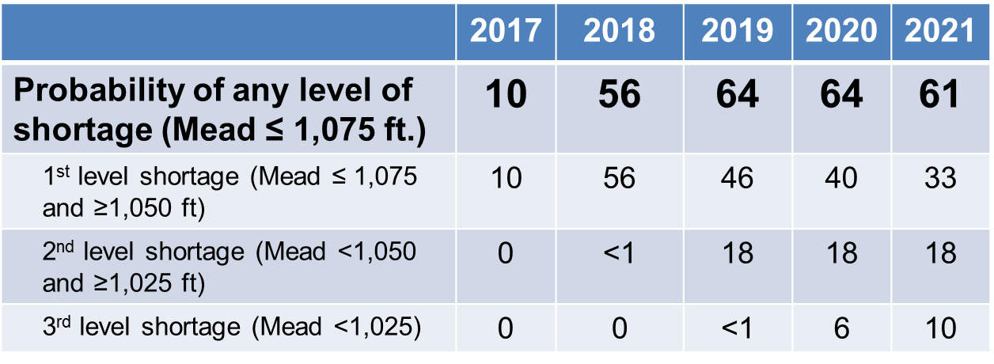
Probabilities of Lower Colorado River Basin Shortage
U.S. Bureau of Reclamation CRSS Model Run – April 2016
Notes:
Reclamation’s April CRSS modeling shows a 10% chance of a shortage in 2017 and 56% chance in 2018, even with a projected 9.0 MAF release from Lake Powell in water Year 2017
Questions???

